Slide 1
Chemical Quantities
Chapter 10

Slide 2
Molar Mass
Molar mass is the sum of atomic masses of the elements in the compound.
  You MUST take into account the number of atoms of each element.
  Example: Ca₃(PO₄)₂
  Ca 3(40.08)
  P 2(30.97)
  +O 8(16.00)
  310.18 g Ca₃(PO₄)₂
  Significant figure rules:
  when adding or subtracting keep the smallest number of decimal places.
  The number of atoms is a counted quantity and has infinite significant figures.

Slide 3
Equality Statements
Chemistry requires converting between different units of measure.
Mole (mol) is the amount of a substance and can be used to show relationships between other units.
1 mol = 22.4 L {of any gas at STP}
1 mol = 6.02 x 1023 particles (ptl)
1 mol = molar mass g

Slide 4
Equality Statements
Note STP means standard temperature and pressure.
  Which is 1 ATM and 273 K
Molar mass is measured in grams and students must find it for each chemical formula.
Particles can include:
  Atoms (unique to elements)
  Molecules (unique to covalent compounds) (mlc)
  Ions (unique for ions)
  Formula Units (unique for ionic compounds) (F.U.)

Slide 5
One Step conversions
Chemistry conversions are all about canceling out the undesired unit to get the desired unit.
When doing conversion you MUST show
  Numbers
  Units {mol, mlc, F.U, g, L}
  Chemical Formulas {example: Ca₃(PO₄)₂}
Steps
  Write number and unit given in the problem
  Multiply by a fraction so that units cancel
  What every your getting rid of goes on bottom, what every our going to goes on top.
  3. Add the correct numbers form your equality statments.

Slide 6
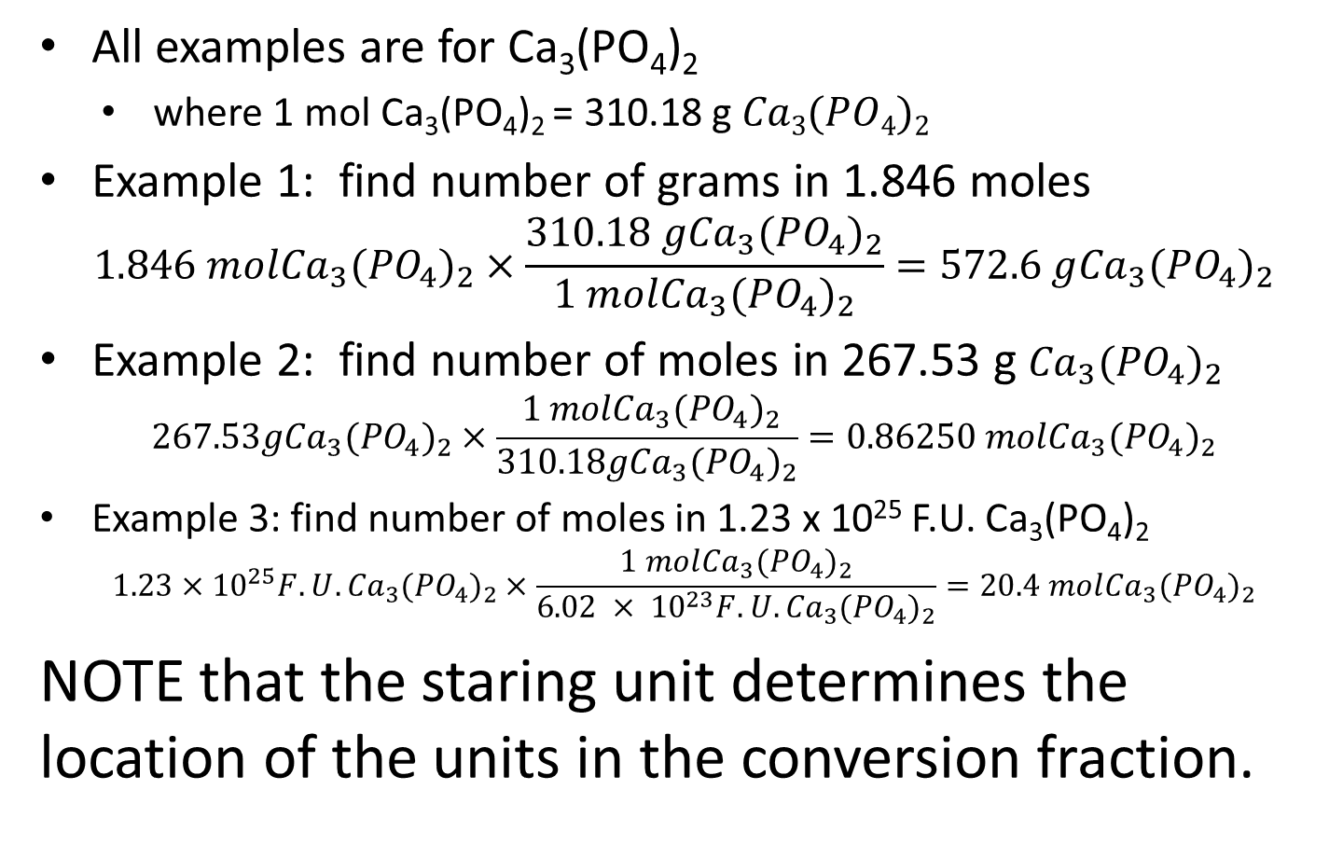
One Step Conversions
  All examples are for Ca₃(PO₄)₂
    where 1 mol Ca₃(PO₄)₂ = 310.18 g $Ca3(PO4)2$
Example 1: find number of grams in 1.846 moles
    $$1.846 mol{Ca}_{3}{(PO}_{4})_{2}×\frac{310.18 g{Ca}_{3}{(PO}_{4})_{2}}{1 mol{Ca}_{3}{(PO}_{4})_{2}}=572.6 g{Ca}_{3}{(PO}_{4})_{2}$$
Example 2: find number of moles in 267.53 g ${Ca}_{3}{(PO}_{4})_{2}$
$$267.53g{Ca}_{3}{(PO}_{4})_{2}×\frac{ 1 mol{Ca}_{3}{(PO}_{4})_{2}}{310.18g{Ca}_{3}{(PO}_{4})_{2}}=0.86250 mol{Ca}_{3}{(PO}_{4})_{2}$$
Example 3: find number of moles in 1.23 x 10²⁵ F.U. Ca₃(PO₄)₂
$$1.23×{10}^{25}F.U.{Ca}_{3}{(PO}_{4})_{2}×\frac{1 mol{Ca}_{3}{(PO}_{4})_{2}}{6.02 × {10}^{23}F.U.{Ca}_{3}{(PO}_{4})_{2}}=20.4 mol{Ca}_{3}{(PO}_{4})_{2}$$
NOTE that the staring unit determines the location of the units in the conversion fraction.

Slide 7
Two Step Conversion
Only allowed to convert using the equality statements below
  1 mol = 22.4 L {of any gas at STP}
  1 mol = 6.02 x 1023 particles (ptl)
  1 mol = molar mass g
When going from grams to L or particles to grams (ect) it requires two conversion factions.
The order of the units in the fractions are determined by what you are starting with and what you want to go to.

Slide 8
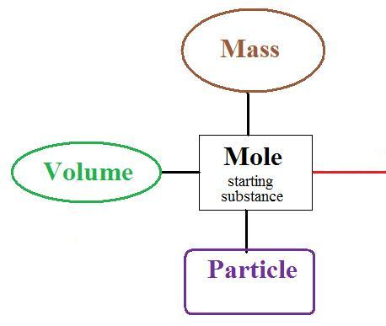
Two Step Conversion
Raines Mole Map
Each bridge is a fraction!
Mole is always 1
Volume is always 22.4 L
Particles is always 6.02 x 10²³ ptl
Mass is always molar mass of compound/element in grams.

Slide 9

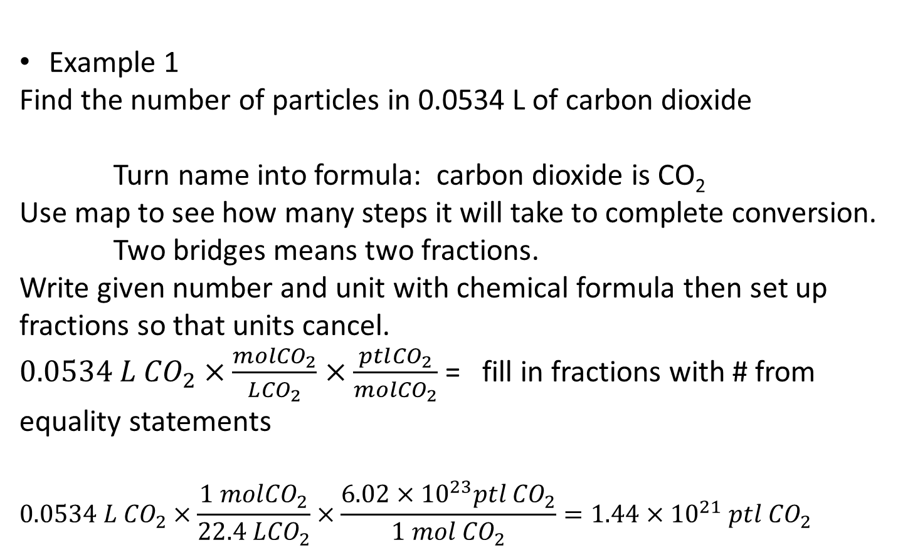
Two Step Conversion
Example 1
Find the number of particles in 0.0534 L of carbon dioxide
Turn name into formula: carbon dioxide is CO₂
Use map to see how many steps it will take to complete conversion.
Two bridges means two fractions.
Write given number and unit with chemical formula then set up fractions so that units cancel.
$0.0534 L {CO}_{2}×\frac{mol{CO}_{2}}{L{CO}_{2}}×\frac{ptl{CO}_{2}}{mol{CO}_{2}}$ = fill in fractions with # from equality statements
$$0.0534 L {CO}_{2}×\frac{1 mol{CO}_{2}}{22.4 L{CO}_{2}}×\frac{6.02×{10}^{23}ptl{ CO}_{2}}{1 mol{ CO}_{2}}=1.44×{10}^{21} ptl{ CO}_{2}$$

Slide 10
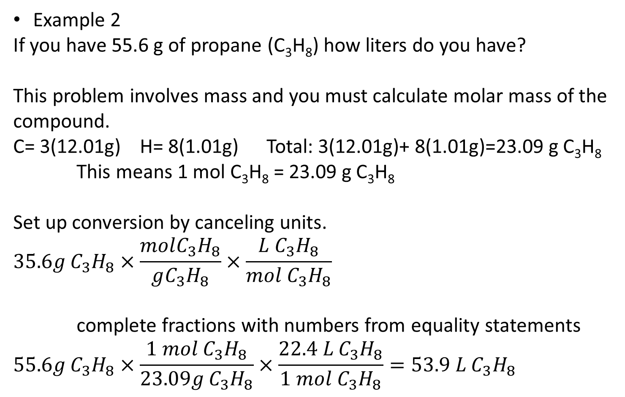
Two Step Conversion
Example 2
If you have 55.6 g of propane (C₃H₈) how liters do you have?
This problem involves mass and you must calculate molar mass of the compound.
C= 3(12.01g) H= 8(1.01g) Total: 3(12.01g)+ 8(1.01g)=23.09 g C₃H₈
This means 1 mol C₃H₈ = 23.09 g C₃H₈
Set up conversion by canceling units.
$$35.6g C_{3}H_{8}×\frac{molC_{3}H_{8}}{gC_{3}H_{8}}×\frac{L{ C}_{3}H_{8}}{mol C_{3}H_{8}}$$
complete fractions with numbers from equality statements
$$55.6g C_{3}H_{8}×\frac{1 mol C_{3}H_{8}}{23.09g C_{3}H_{8}}×\frac{22.4 L{ C}_{3}H_{8}}{1 mol C_{3}H_{8}}=53.9 L{ C}_{3}H_{8}$$

Slide 11
Two Step Conversion
Example 1

Slide 12
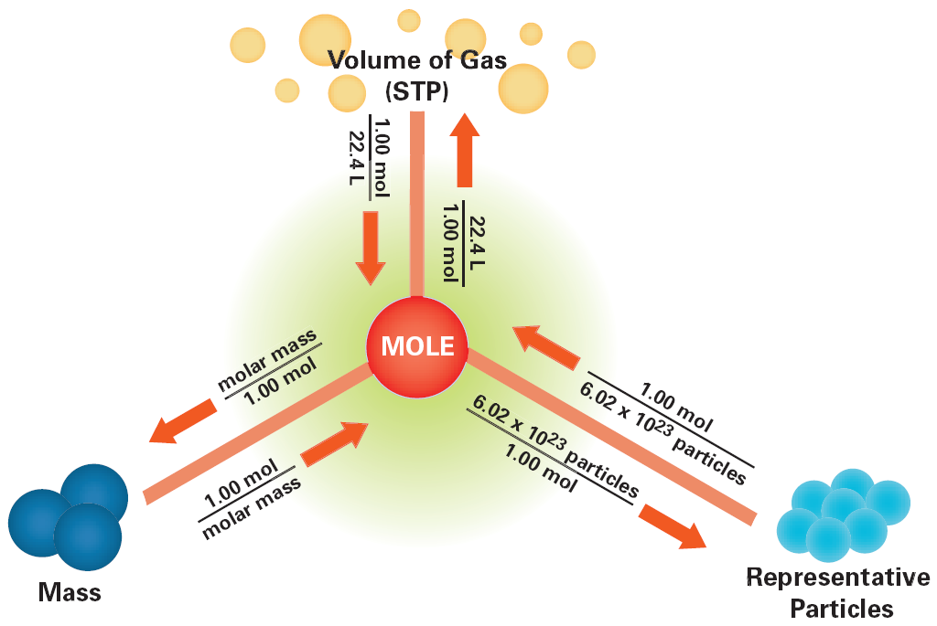
Text book mole map

Slide 13
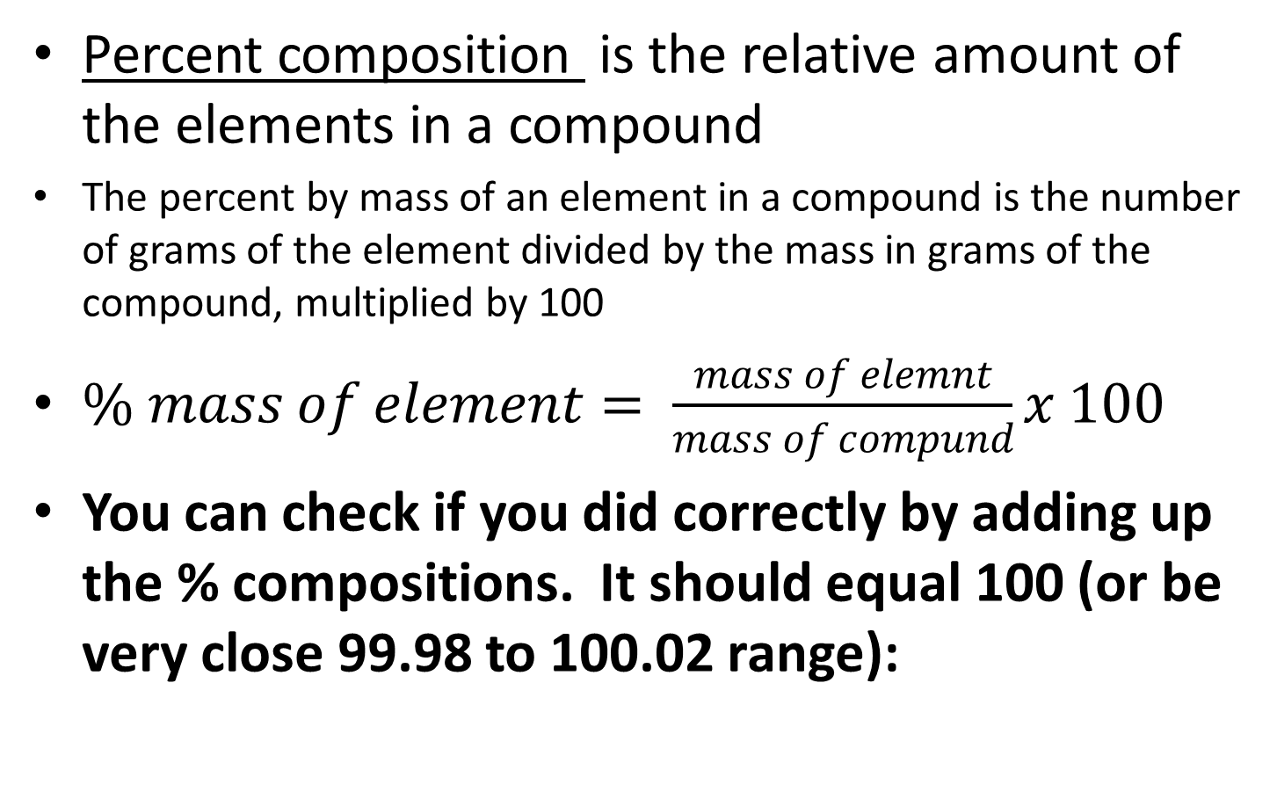
Percent composition
Percent composition is the relative amount of the elements in a compound
The percent by mass of an element in a compound is the number of grams of the element divided by the mass in grams of the compound, multiplied by 100
$\% mass of element= \frac{mass of elemnt}{mass of compund}x 100$
You can check if you did correctly by adding up the % compositions. It should equal 100 (or be very close 99.98 to 100.02 range):

Slide 14
Percent Composition Example 1
Find the percent composition of each element in H₂O
Mass of H₂O = 2(1.01)+1(16.00)=18.02g
Mass of hydrogen in H₂O = 2(1.01) =2.02 g
  % comp of hydrogen = 2.02g/18.02g x 100= 11.21% hydrogen
Mass of oxygen in H₂O = 1(16.00)=16.00 g
  % comp of oxygen = 16.00g/18.02g x 100= 88.79% oxygen
Check: 11.21% hydrogen + 88.79% oxygen = 100 % total so work was correct

Slide 15
Percent Composition Example 2
Find the percent composition of each element in Ca₃(PO₄)₂
Mass of Ca₃(PO₄)₂= 3(40.08) + 2(30.97) + 8(16.00)= 310.18 g
Mass of Calcium in Ca₃(PO₄)₂ = 3(40.08) = 120.24 g
  % comp of calcium = 120.24g/310.18g x 100 = 38.76 % Ca
Mass of phosphorous in Ca₃(PO₄)₂ = 2(30.97) = 61.94 g
  % comp of phosphorous = 61.94 / 310.18 x 100 = 19.97% P
Mass of oxygen = 8 (16.00) = 128.00 g
  % comp of oxygen = 128.00g /310.18g x 100 = 41.27% O
Check: 38.76 % + 19.97% + 41.27% = 100%

Slide 16
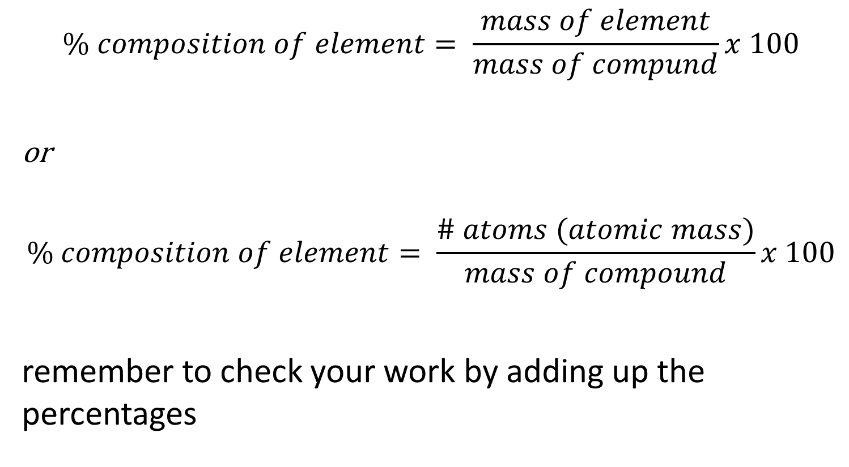
Percent composition
$$\% composition of element= \frac{mass of element}{mass of compund}x 100$$
or
$$\% composition of element= \frac{\# atoms (atomic mass)}{mass of compound}x 100$$
remember to check your work by adding up the percentages

Slide 17
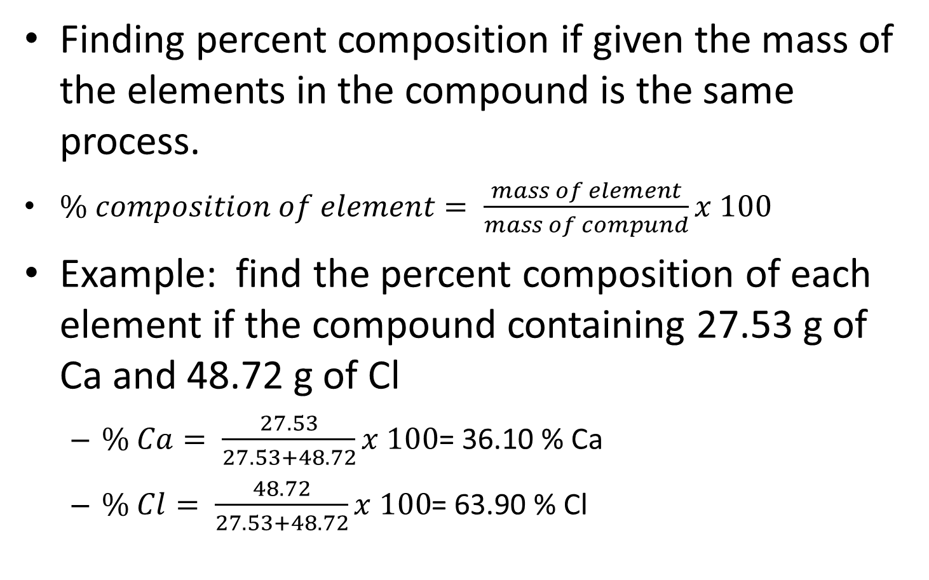
Percent composition with masses
Finding percent composition if given the mass of the elements in the compound is the same process.
$\% composition of element= \frac{mass of element}{mass of compund}x 100$
Example: find the percent composition of each element if the compound containing 27.53 g of Ca and 48.72 g of Cl
  $\% Ca= \frac{27.53}{27.53+48.72}x 100$= 36.10 % Ca
  $\% Cl= \frac{48.72}{27.53+48.72}x 100$= 63.90 % Cl

Slide 18
Using Percent Composition
If you know the percent composition (or can calculate it) it can be used to find the mass of an element in compound.
  total Mass (% in decimal form) = mass of element
Example: You have a 58.24 g sample of a substance that contains 25.0% hydrogen. What is the mass of hydrogen in the sample
  58.24g (.0250)=14.56 g hydrogen

Slide 19
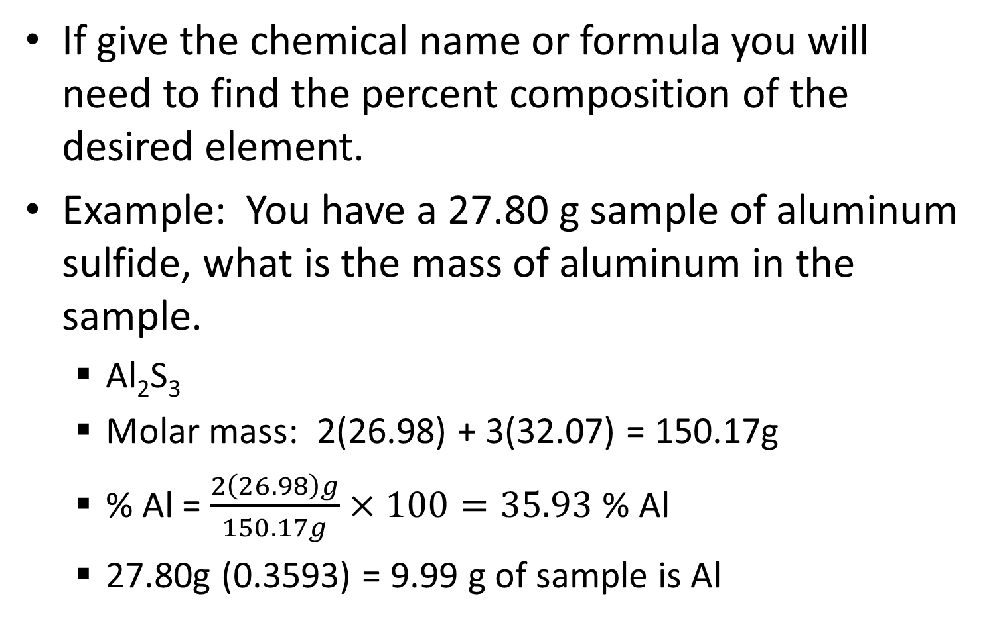
Using Percent Composition
If give the chemical name or formula you will need to find the percent composition of the desired element.
Example: You have a 27.80 g sample of aluminum sulfide, what is the mass of aluminum in the sample.
  Al₂S₃
  Molar mass: 2(26.98) + 3(32.07) = 150.17g
  % Al = $\frac{2\left(26.98\right)g}{150.17g}×100=35.93$ % Al
  27.80g (0.3593) = 9.99 g of sample is Al

Slide 20
Empirical formula
Empirical formula gives the lowest whole-number ratio of the atoms of the elements in a compound
An empirical formula may or may not be the same at a molecular formula
The empirical formula of a compound shows the smallest whole-number ratio of the atoms in the compound
Example: methane is C₂H₆, empirical formula would be CH₃.

Slide 21
Finding Empirical Formulas
IF given % assume you have a 100 g sample and the % turns into grams.
Turn grams of each element into moles of the element. (use mass to mole conversion).
Get whole number ratio of elements. (Divide all by smallest # of moles)
Use whole numbers as subscripts in chemical formulas

Slide 22
Empirical formula example 1
Find empirical formula for compound containing 67.7% mercury, 10.8% sulfur, and 21.6% oxygen.
67.7 g Hg, 10.8 g S, 21.6 g O
Mole Hg= 67.7gx (1mol/200.59g) =0.34 molHg Mol S = 10.8 g x (1mol/32.07g)=0.34 mol S mol O = 21.6 g x (1mol/16.00g)= 1.35 mol O
# of Hg = (0.34/0.34) = 1 Hg # of S = (0.34/0.34) = 1 S # of 0 = (1.35/0.34) = 3.97 = 4 O
HgSO₄

Slide 23
Empirical Formula
When you find the ratio of atoms be on the look out for numbers that indicate you have to multiply.
  Ratios of 1.5, 2.5 …. Indicate you need to multiply by 2
  Ratios of 1.33, 2.33 … indicate you need to multiply by 3
If your ratio is very close to the whole number round to the whole number. 1.02 would round to 1, 2.97 would round to 3.

Slide 24
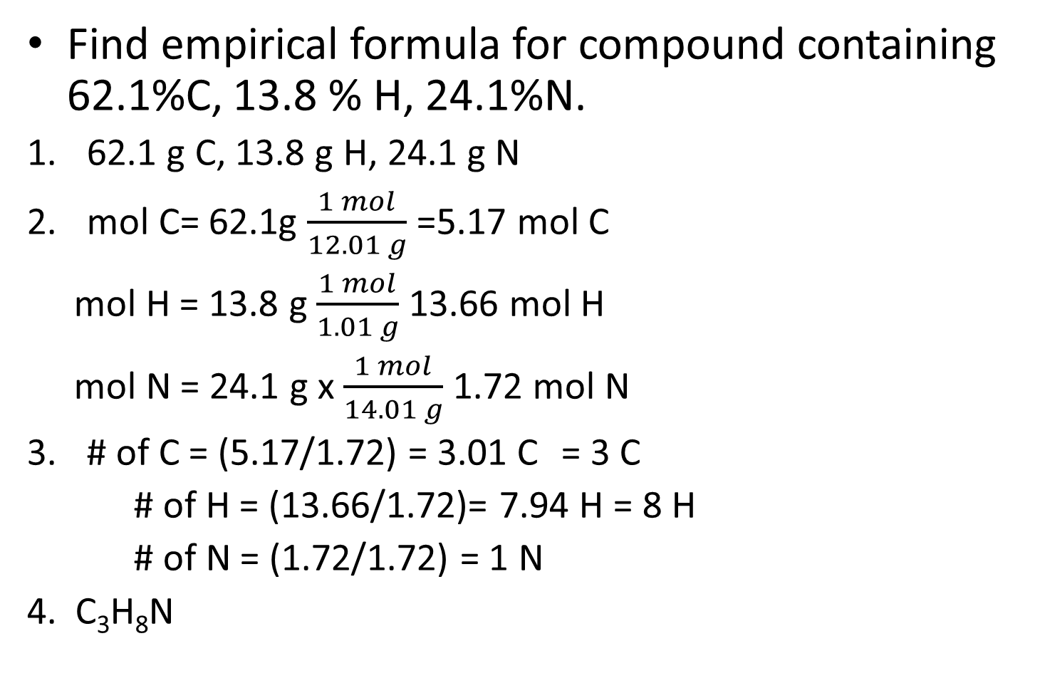
Empirical formula example 2
Find empirical formula for compound containing 62.1%C, 13.8 % H, 24.1%N.
62.1 g C, 13.8 g H, 24.1 g N
mol C= 62.1g $\frac{1 mol}{12.01 g}$=5.17 mol C
  mol H = 13.8 g $\frac{1 mol}{1.01 g}$13.66 mol H
  mol N = 24.1 g x $\frac{1 mol}{14.01 g}$1.72 mol N
# of C = (5.17/1.72) = 3.01 C = 3 C
# of H = (13.66/1.72)= 7.94 H = 8 H
# of N = (1.72/1.72) = 1 N
4. C₃H₈N

Slide 25
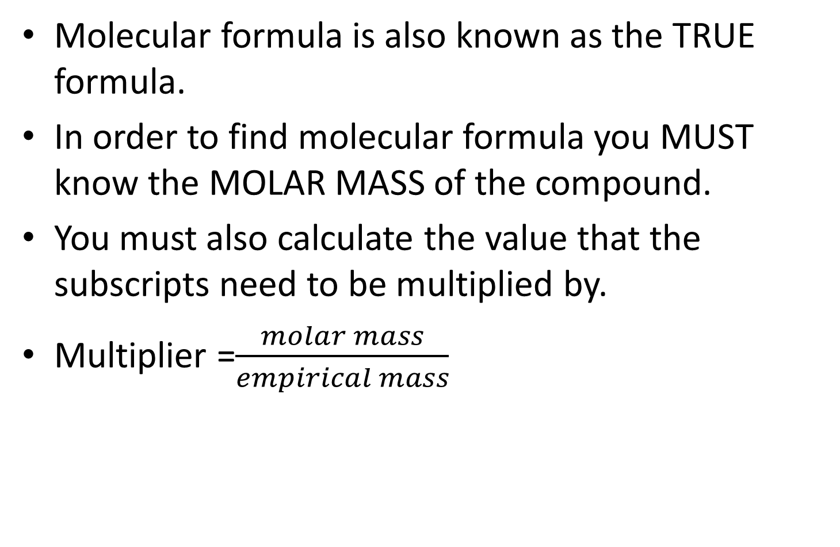
Molecular formula
Molecular formula is also known as the TRUE formula.
In order to find molecular formula you MUST know the MOLAR MASS of the compound.
You must also calculate the value that the subscripts need to be multiplied by.
Multiplier =$\frac{molar mass}{empirical mass}$

Slide 26
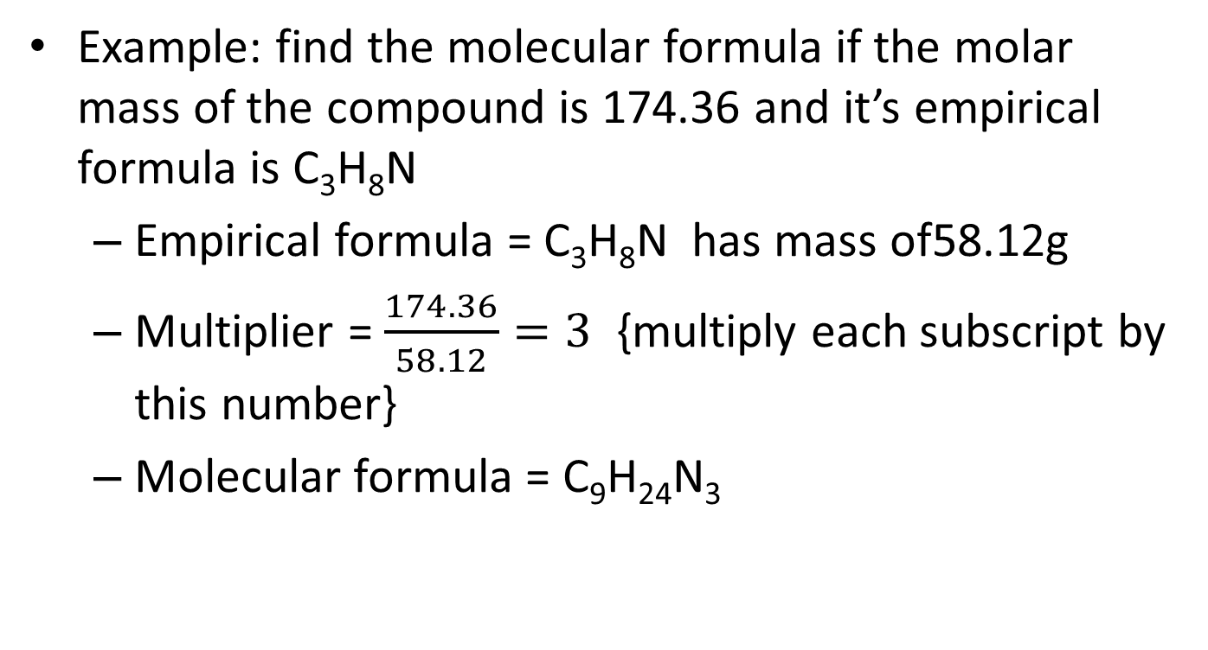
Molecular Formula Example 1
  Example: find the molecular formula if the molar mass of the compound is 174.36 and it’s empirical formula is C₃H₈N
  Empirical formula = C₃H₈N has mass of58.12g
  Multiplier = $\frac{174.36}{58.12}=3$ {multiply each subscript by this number}
  Molecular formula = C₉H₂₄N₃

Slide 27
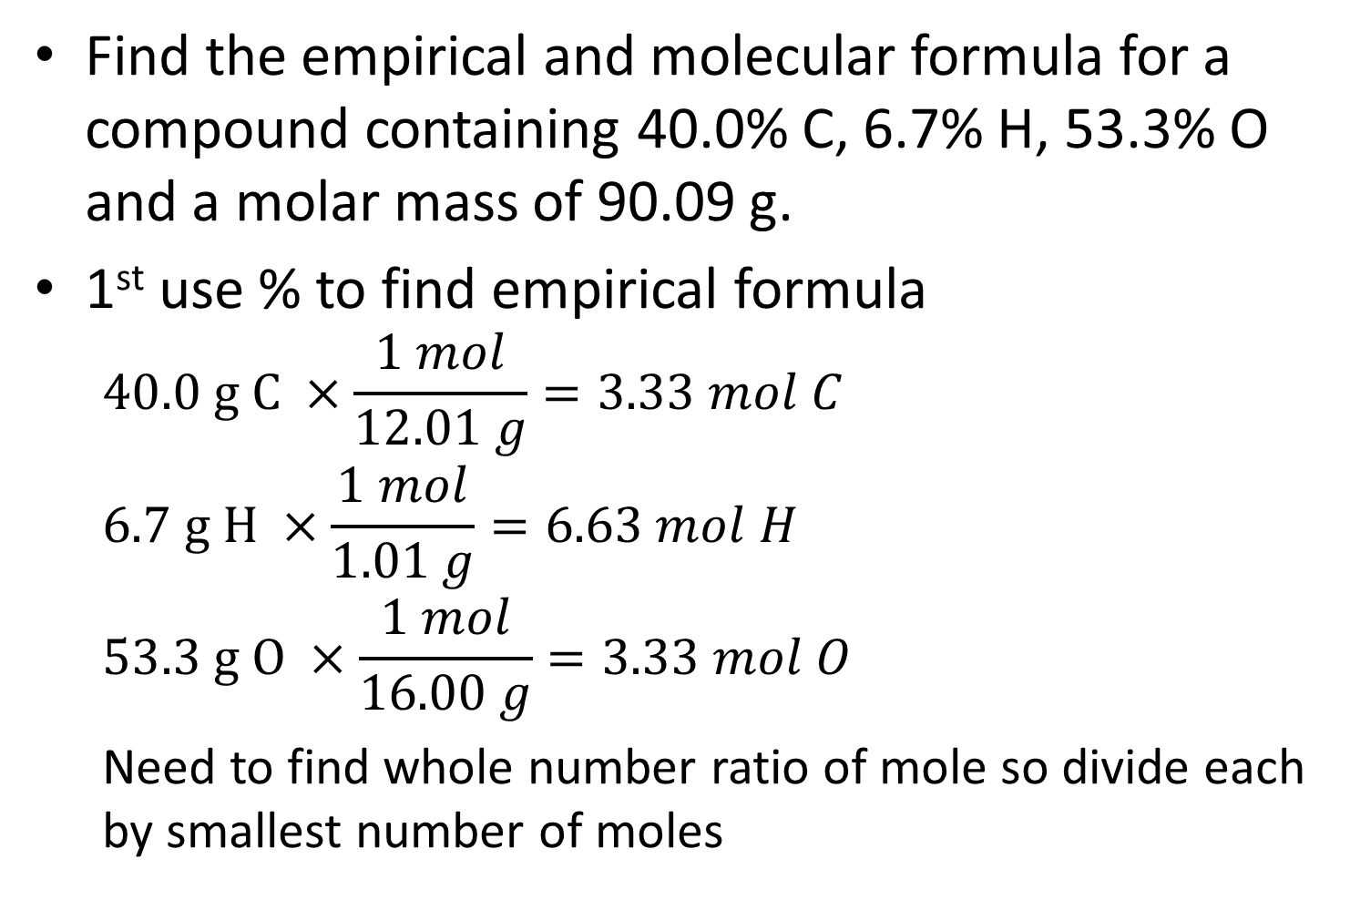
Example 2
Find the empirical and molecular formula for a compound containing 40.0% C, 6.7% H, 53.3% O and a molar mass of 90.09 g.
1st use % to find empirical formula
  $$40.0 g C ×\frac{1 mol}{12.01 g}=3.33 mol C$$
  $$6.7 g H ×\frac{1 mol}{1.01 g}=6.63 mol H$$
  $$53.3 g O ×\frac{1 mol}{16.00 g}=3.33 mol O$$
  Need to find whole number ratio of mole so divide each by smallest number of moles

Slide 28
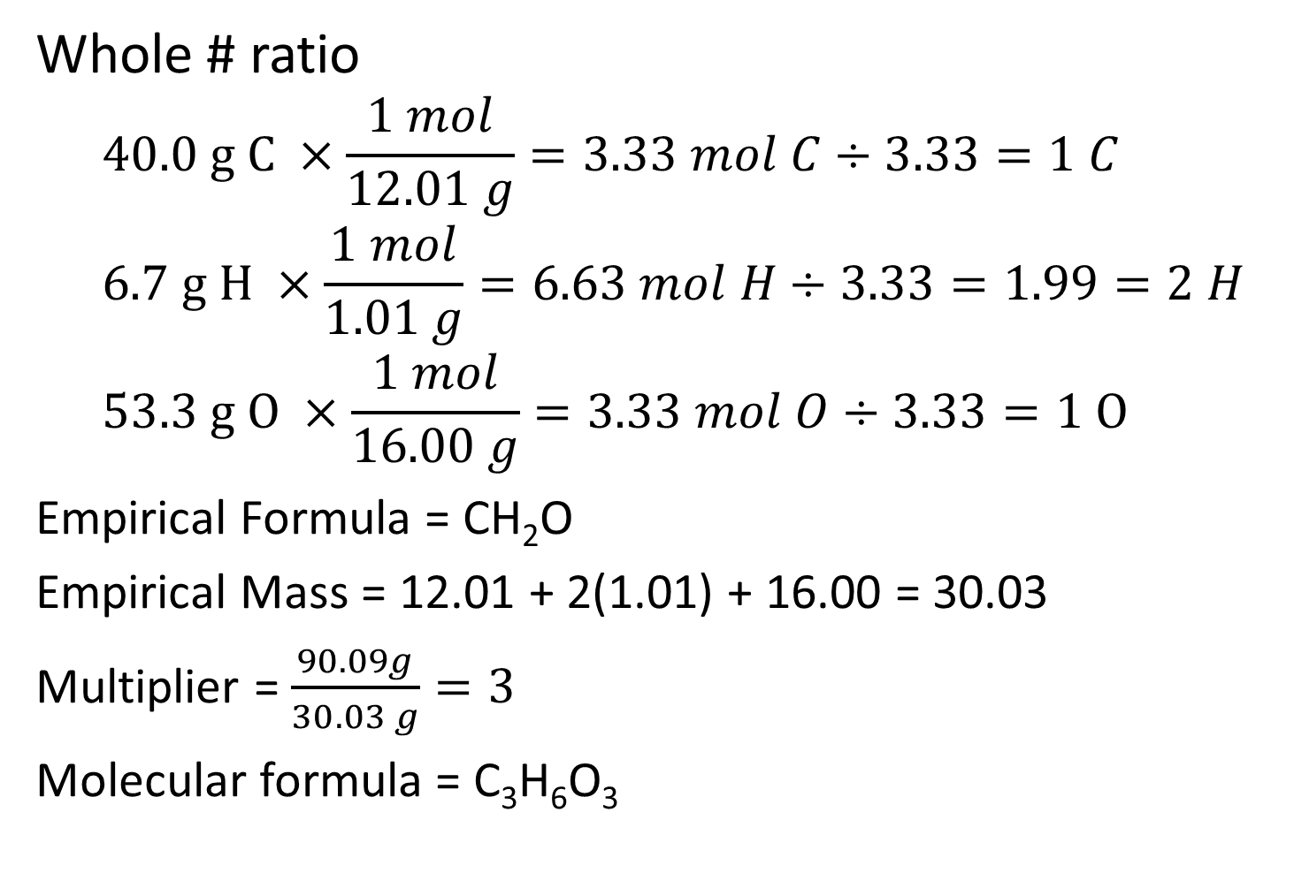
Example 2
Whole # ratio
  $$40.0 g C ×\frac{1 mol}{12.01 g}=3.33 mol C÷3.33=1 C$$
  $$6.7 g H ×\frac{1 mol}{1.01 g}=6.63 mol H÷3.33=1.99=2 H$$
  $$53.3 g O ×\frac{1 mol}{16.00 g}=3.33 mol O÷3.33=1 O$$
  Empirical Formula = CH₂O
  Empirical Mass = 12.01 + 2(1.01) + 16.00 = 30.03
  Multiplier = $\frac{90.09g}{30.03 g}=3$
  Molecular formula = C₃H₆O₃

